Slide 1
SEMANTIC WEB MINING:
FIND ARs in Linked Open Data Sets
By-
Bryceleen D’souza(7057)
Leon Suraj D’souza(7058)
Mugesh Nadar(7087)
-Under Mentor Prof. Swati Ringe

Slide 2

Semantic Web?Huh?
Web 3.0
Promotes Common Data Format for exchange of information.
Promotes Open Formats →
Aims to make the Web a Machine Readable Entity

Slide 3
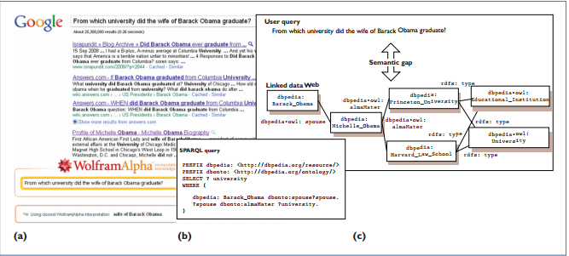
MIND THE GAP!

Slide 4
Problem Statement
An algorithm, named SWApriori, has been proposed which has considered the above challenges and without the end user involvement, mines ARs directly from a single semantic web dataset. The problem statement includes collecting and connecting them so that all data appear as a single and central dataset and then using existing methods to mine ARs from the generated dataset.

Slide 5
Description
Use following slides for discussing status, schedules, budget, etc.
-for more info…
List location or contact for specification (or other related documents)

Slide 6
Competitive Analysis
Competitors
You may want to allocate one slide per competitor
Strengths
Your strengths relative to competitors
Weaknesses
Your weaknesses relative to competitors

Slide 7
Competitive Analysis, Cont.
Competitors
Strengths
Weaknesses
-for more info…
List location or contact for competitive analysis (or other related documents)

Slide 8
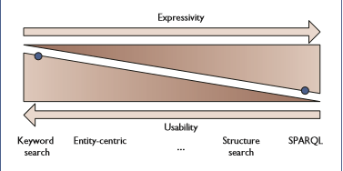
Technology
SPARQL, Jena
SPARQL allows to query Ontologies, Data Sets while Jena provides the Java Powered platform independency required.

Slide 9
Team Resources
State assumptions about resources allocated to this project
People
Equipment
Locations
Support & outside services
Manufacturing
Sales

Slide 10
Procedures
Highlight any procedural differences from usual projects of this type
Discuss requirements, benefits, and issues of using new procedures
-for more info…
List location or contact for procedures document (or other related documents)

Slide 11
Schedule
Review high-level schedule
-for more info…
List location or contact for detailed schedule (or other related documents)

Slide 12
Current Status
High-level overview of progress against schedule
On-track in what areas
Behind in what areas
Ahead in what areas
Unexpected delays or issues

Slide 13
Related Documents
Marketing plan
Location or contact name/phone
Budget
Location or contact name/phone
Post-mortem
Location or contact name/phone
Submit questions
Location or contact name/phone

